Slide 1


Capstone Project - The Battle of Neighborhoods
Vinodhini V.

Slide 2
Introduction
Business Objective :
Identify the best location to setup a coffee shop in Bangalore based on location proximity and ratings of existing shops in the neighborhood.
For a new business to start-up a coffee-shop in Bangalore, sufficient research must be done to identify the best location. The current analytics project will aid to narrow down the locations based on the coffee-shops in the neighborhood and their ratings.

Slide 3
Data Requirements
Data required for this analysis :
List of Neighborhoods in Bangalore - https://en.wikipedia.org/wiki/List_of_neighbourhoods_in_Bangalore
Latitude and Longitude details of the Neighborhoods
List of coffeeshops in each neighborhood (Extracted from Foursquare )
Ratings of the coffee shops ( Extracted from Foursquare)
Neighborhood details and their latitude and longitude information helps to fetch the details of the coffee shops in each locality.
Ratings of each coffee shop helps in the analysis to answer the objective.

Slide 4
Methodology
Exploratory Analysis :
There are about 64 prominent neighborhoods in the city of Bangalore, spread on the north, south, east and west of Bangalore.
In these 64 locations, 128 coffee shops are located as found on Foursquare.
Only 37 out of 128 coffee shops has a rating listed on Foursquare.
The mean of the rating is 6.3 with maximum being 7.7 and minimum as 5.1.

Slide 5
Methodology
Data Clean-up/Preparation:
Any null values are treated by dropping the records.
Coffee shops with no rating are imputed suitably.
Machine Learning Model :
Unsupervised Clustering using KMeans is preferred approach.
Clustering will be applied to understand the proximity and distribution of coffee-shops in the neighborhood.
Clustering on the ratings will be done to understand how the coffee shops are distributed based on rating and locality.
Elbow method will be applied to identify the suitable number of clusters.
Validations done by plotting the output of cluster over maps and reviewed manually.

Slide 6
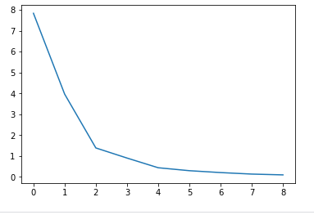
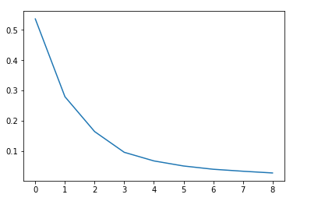
Results
Optimum number of clusters for neighborhood proximity and rating of coffee shops was 2.
Optimum number of clusters for neighborhood proximity of coffee shops was 3.
Bangalore East has coffee shops sparsely distributed compared to other regions.
Out of the many Coffee shops listed, only 37 have been rated. Most of the ratings hover around 5-7. Ratings of 6-7 are mostly seen around Bangalore North-West.

Slide 7
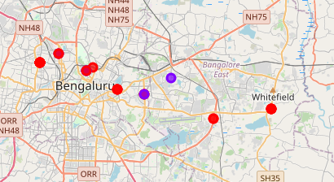
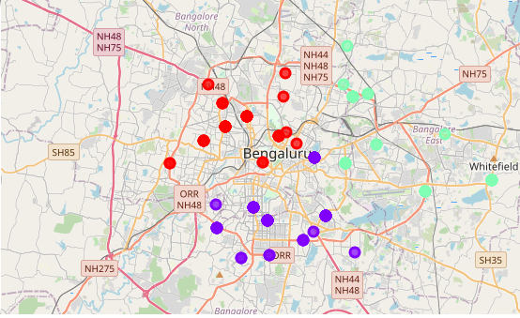
Results
Cluster distribution – Coffeeshops with ratings
Cluster distribution – Coffeeshops in Neighborhood

Slide 8
Discussion and Conclusion
The outcome of this project along with other Market Research related to
i. population and surroundings
ii ratings on other platforms for Coffee shops
iii Coffee variants and other beverages offered
can help finalize the optimal location for setting up a Coffee shop.
This standalone analysis suggests potential opportunities in East Bangalore as there is lack of good rated coffee shops.

